Slide 1

CO-AID
~A hospital management system

Slide 2

Mini project guide:
Members:
Vaidik Vadhavana
Sejal Yadav
Om Walanju
Shriya Vidwans
Prof.A.R.Kalugade

Slide 3

What is this project about?(abstract)
Co-AID Hospital management System is a web application for the hospital which manages doctors and patients. In this project, we use Python and SQLite database. A responsive web-app with aesthetic and accessible UI for managing COVID patients of a certain hospital.

Slide 4

Problem definition:
Coronavirus disease (COVID-19) is an infectious disease. It has become a worldwide concern now. A number of patients have died due to a lack of resources. The city's hospitals are desperate and some have been issuing daily warnings, saying they are left with just a few hours of oxygen. Then the government swings into action and resources are sent, which is often enough to run the hospital, but then they don’t have a proper system to manage these resources neither do the patients know what would we available where. In such case to avoid mess we bring our website in action.

Slide 5
Features(objective):
1) Enter patient details in the database.
2) Retrieve patient details from the database.
3) Get access to all the patient information.
4) Current Covid-19 cases in India.

Slide 6

Scope:
Seat Management ,Equipment Management, Doctor Management. Here you can search patients wrt to name, bed no. doctor assigned and status and other information would be provided as it is need of the hour. Not only until covid lasts even after the pandemic the site can be used for some other diseases and information. So overall it would be a very helpful and to the point project

Slide 7


Impact of our project on society:
The world of work has been profoundly affected by the global virus pandemic. In addition to the threat to public health, the economic and social disruption threatens the long-term livelihoods and wellbeing of millions.
In such a dreadful situation our project contributes a help towards the society by providing a suitable platform which would help in management of the hospitals regarding the covid services.

Slide 8

Existing System:
It would have user and also hospital login in order to provide useful information.
It would also give vaccine regarding information.
Information would be kept up-to-date as we have a seperate hospital login.
It would be easily accessible and easy language to understand.

Slide 9
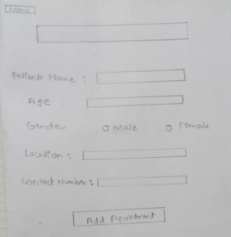
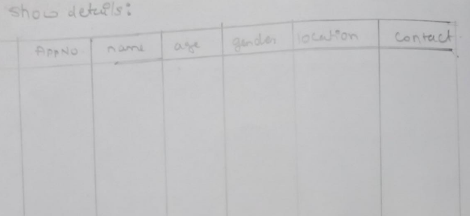
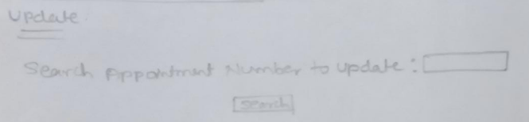
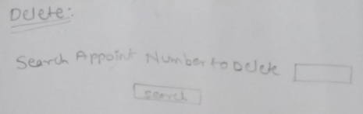
Project design:

Slide 10
HTML
Database
SQLite
Python
Technical requirements

Slide 11
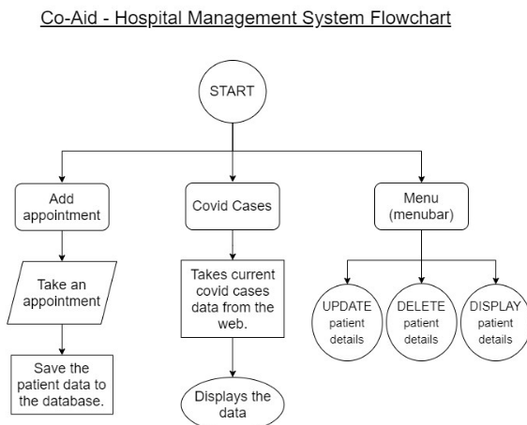
Flow of modules:

Slide 12

Thankyou
Stay safe ☺

